Slide 1
Global Agricultural Production and Population Analysis
Project 1
Corey Holton, Elena Gehle, Domenic Guerrer, and Roberta Chandler

Slide 2
Overview
Introduction
Background: This project analyzes global agricultural production relative to population data over time. It uses Python to process data on agricultural production by category, and country, as well as global and continental population data. The goal is to visualize trends and relationships between food production and population growth.
Purpose: Explain the significance of understanding the relationship between agricultural production and population.
Objective: To analyze how global agricultural production has changed relative to population over time, focusing on key agricultural products.
2. Research Questions
Key Questions:
How has the production of major agricultural products (e.g., meat, vegetables, grains) evolved over time?
How does agricultural production vary across different countries and continents?
What trends can be observed in the relationship between agricultural production and population growth?

Slide 3
Analysis and Conclusion
Findings are strongly supported with numbers and visualizations (10 points).
Write-up summarizes major findings and implications at a professional level (10 points).
Each question in the project proposal is answered with precise descriptions and findings (5 points).
Each question response is supported with a well-discerned statistical analysis from lessons, such as aggregation, correlation, comparison, summary statistics, sentiment analysis, and time series analysis (5 points).

Slide 4
Visualizations
6–8 visualizations of data (at least two per question) (10 points).
Clear and accurate labeling of images (5 points).
Visualizations supported with ample and precise explanation (5 points).

Slide 5
Presentation Requirements
Your presentation should cover the following:
An executive summary or overview of the project and project goals (5 points).
An overview of the data collection, cleanup, and exploration processes (5 points).
The approach that your group took in achieving the project goals (5 points).
Any additional questions that surfaced, what your group might research next if more time was available or share a plan for future development (5 points).
The results and conclusions of the application or analysis (5 points).
Slides effectively demonstrate the project (3 points).
Slides are visually clean and professional (2 points).

Slide 6
How has the production of major agricultural products (e.g., meat, vegetables, grains) evolved over time?

Slide 7
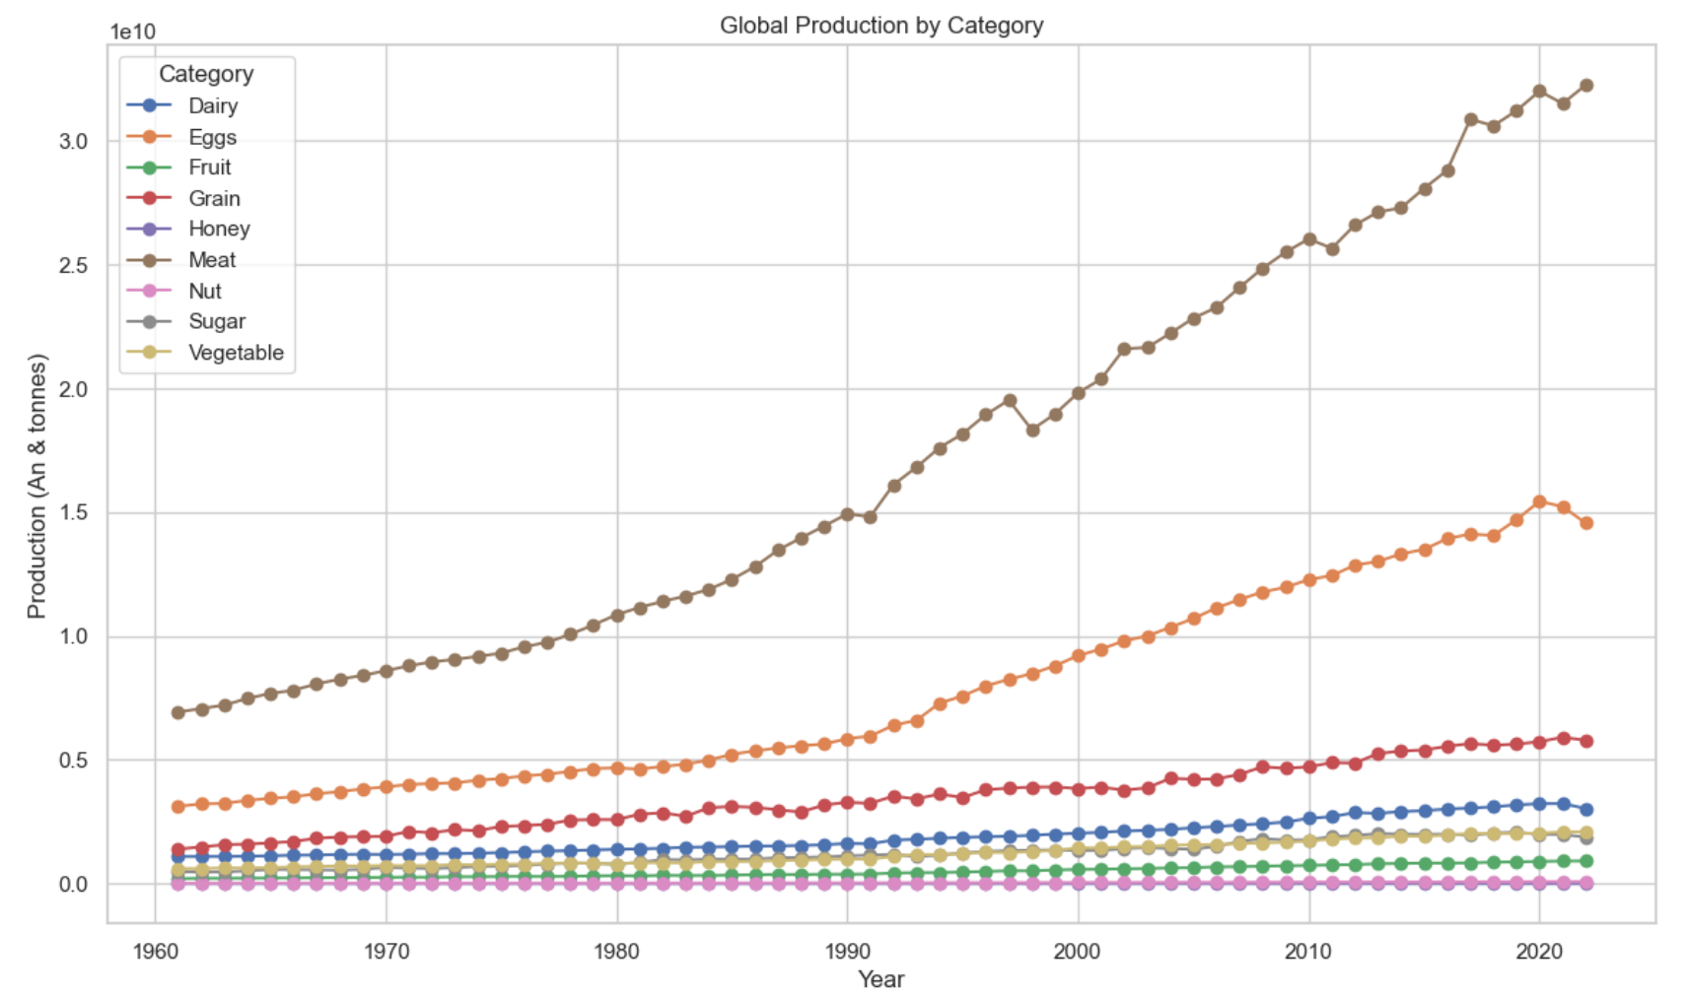

Slide 8
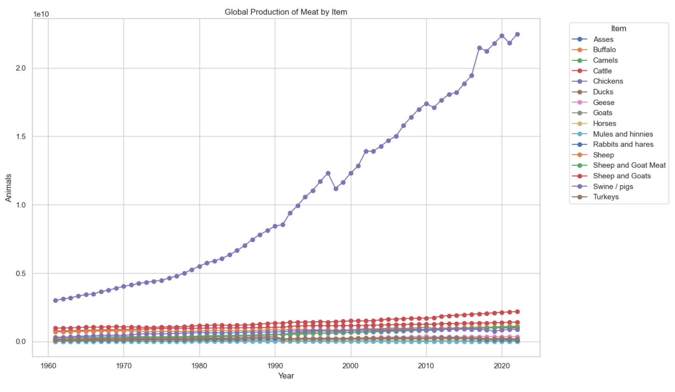

Slide 9
How does agricultural production vary across different countries and continents?

Slide 10
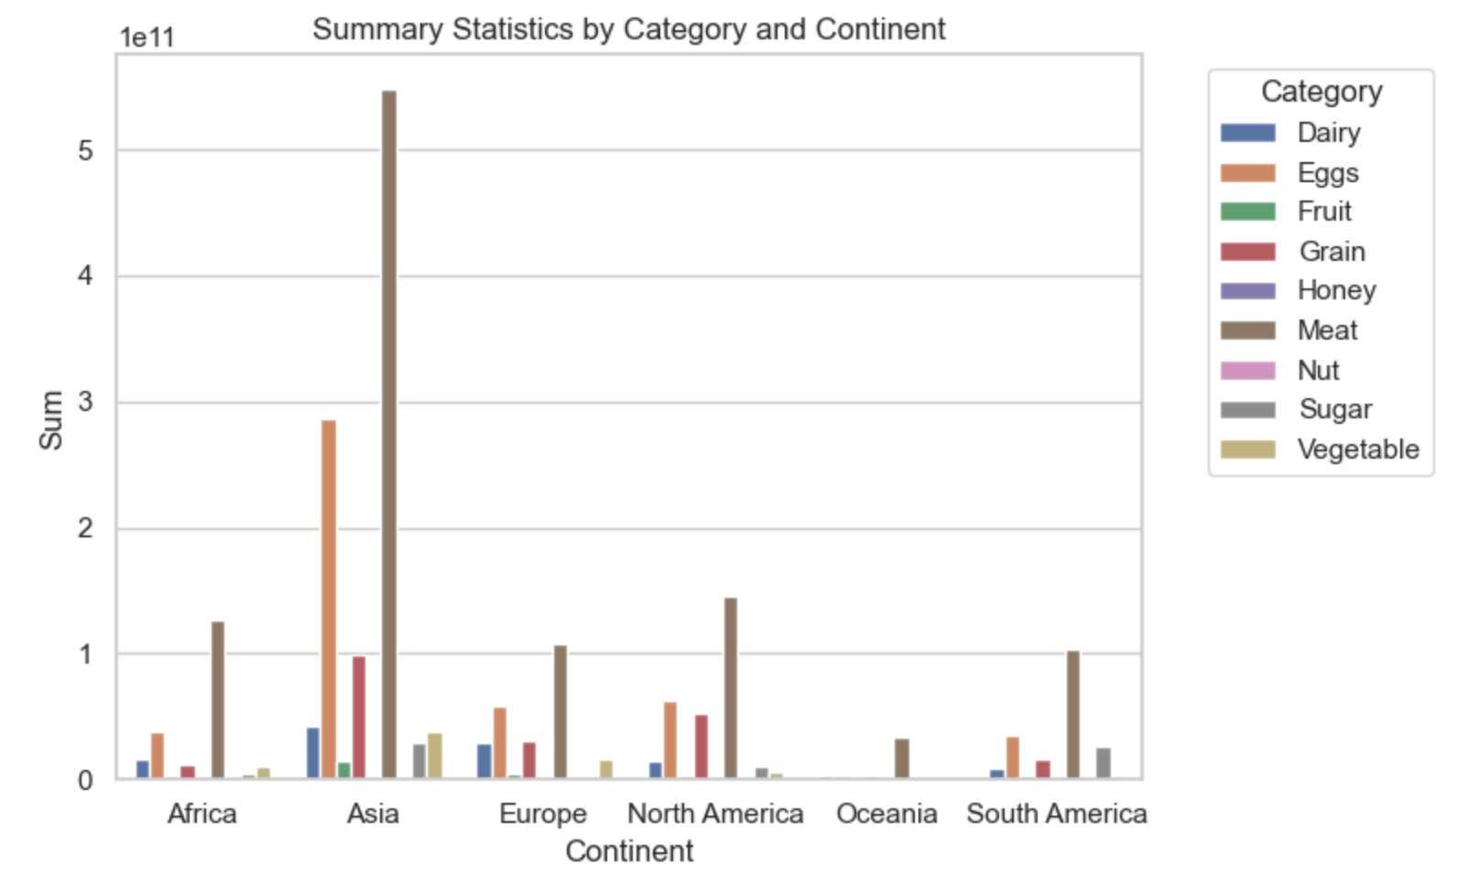
Production of category by continent (sum)

Slide 11
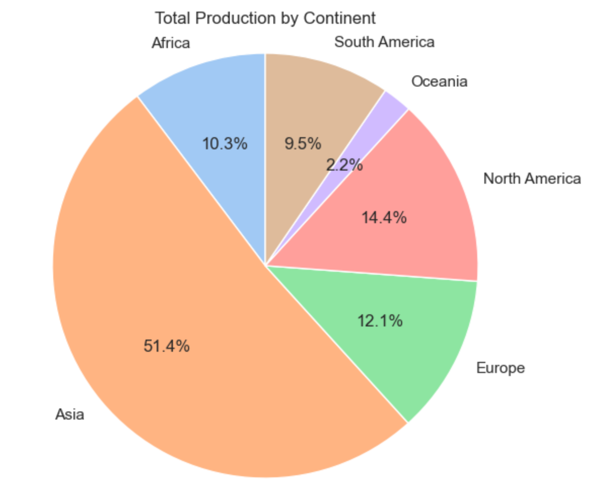
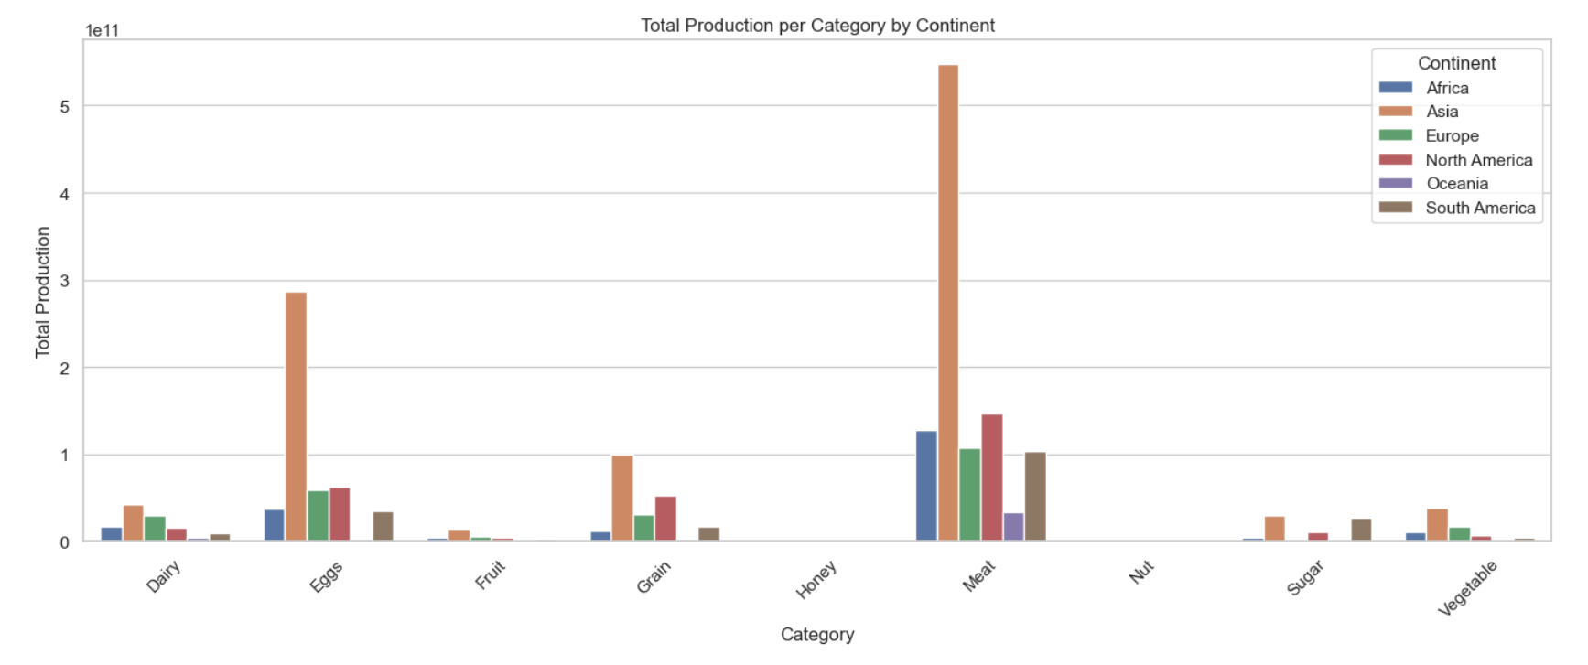
Sum of sums
sum

Slide 12
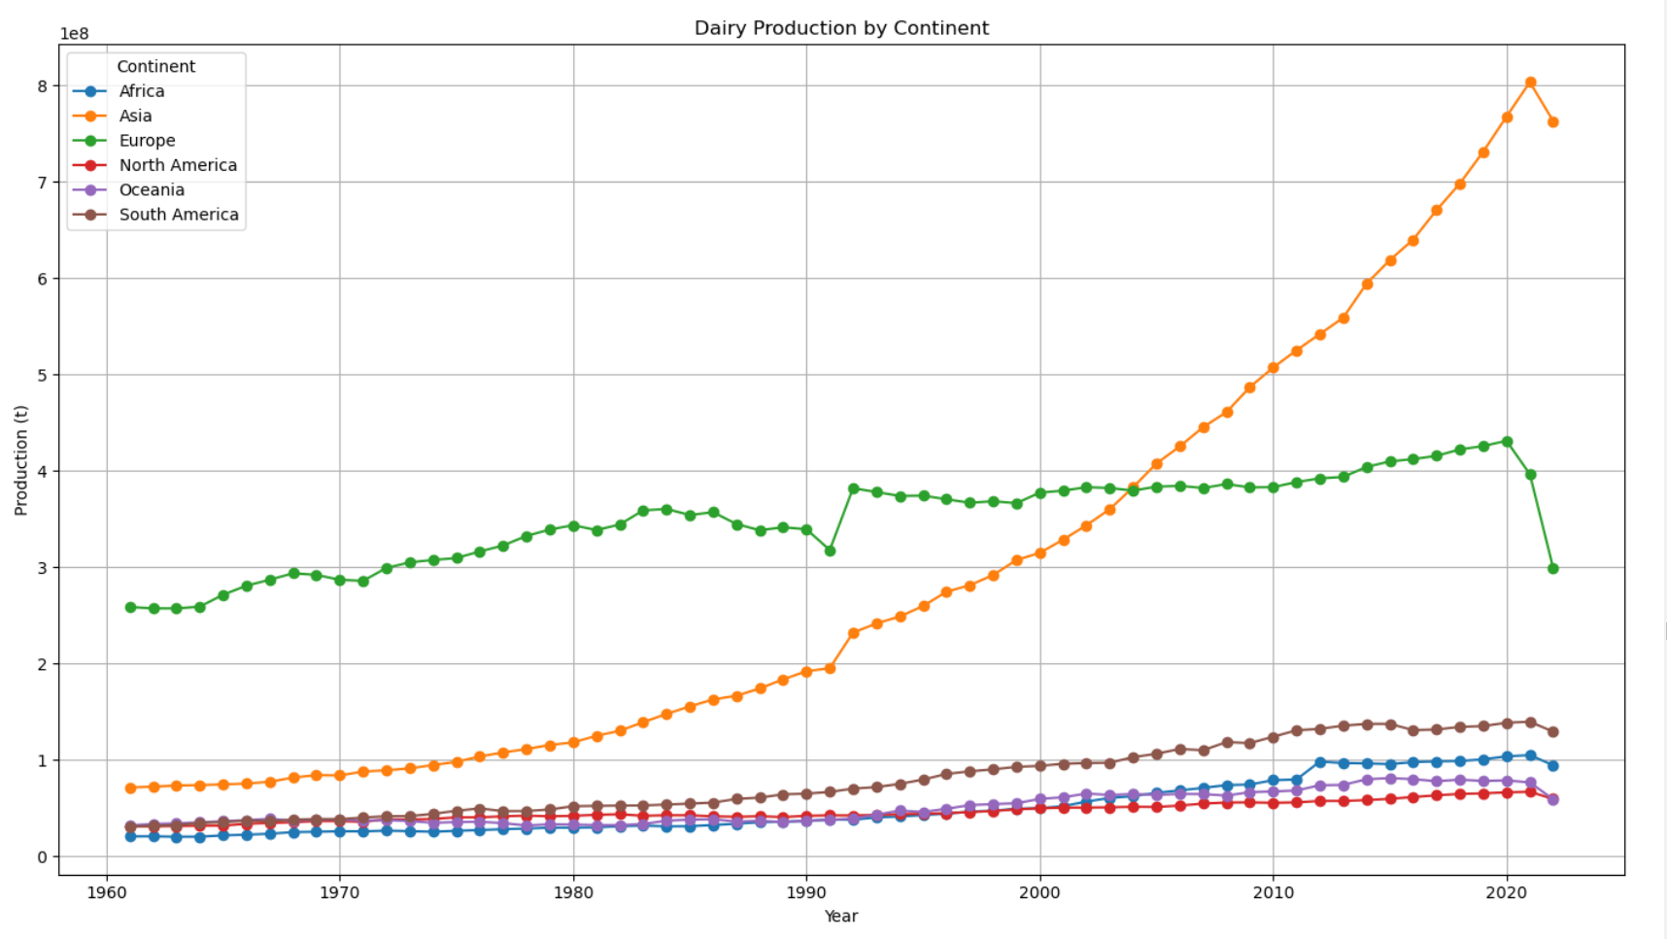
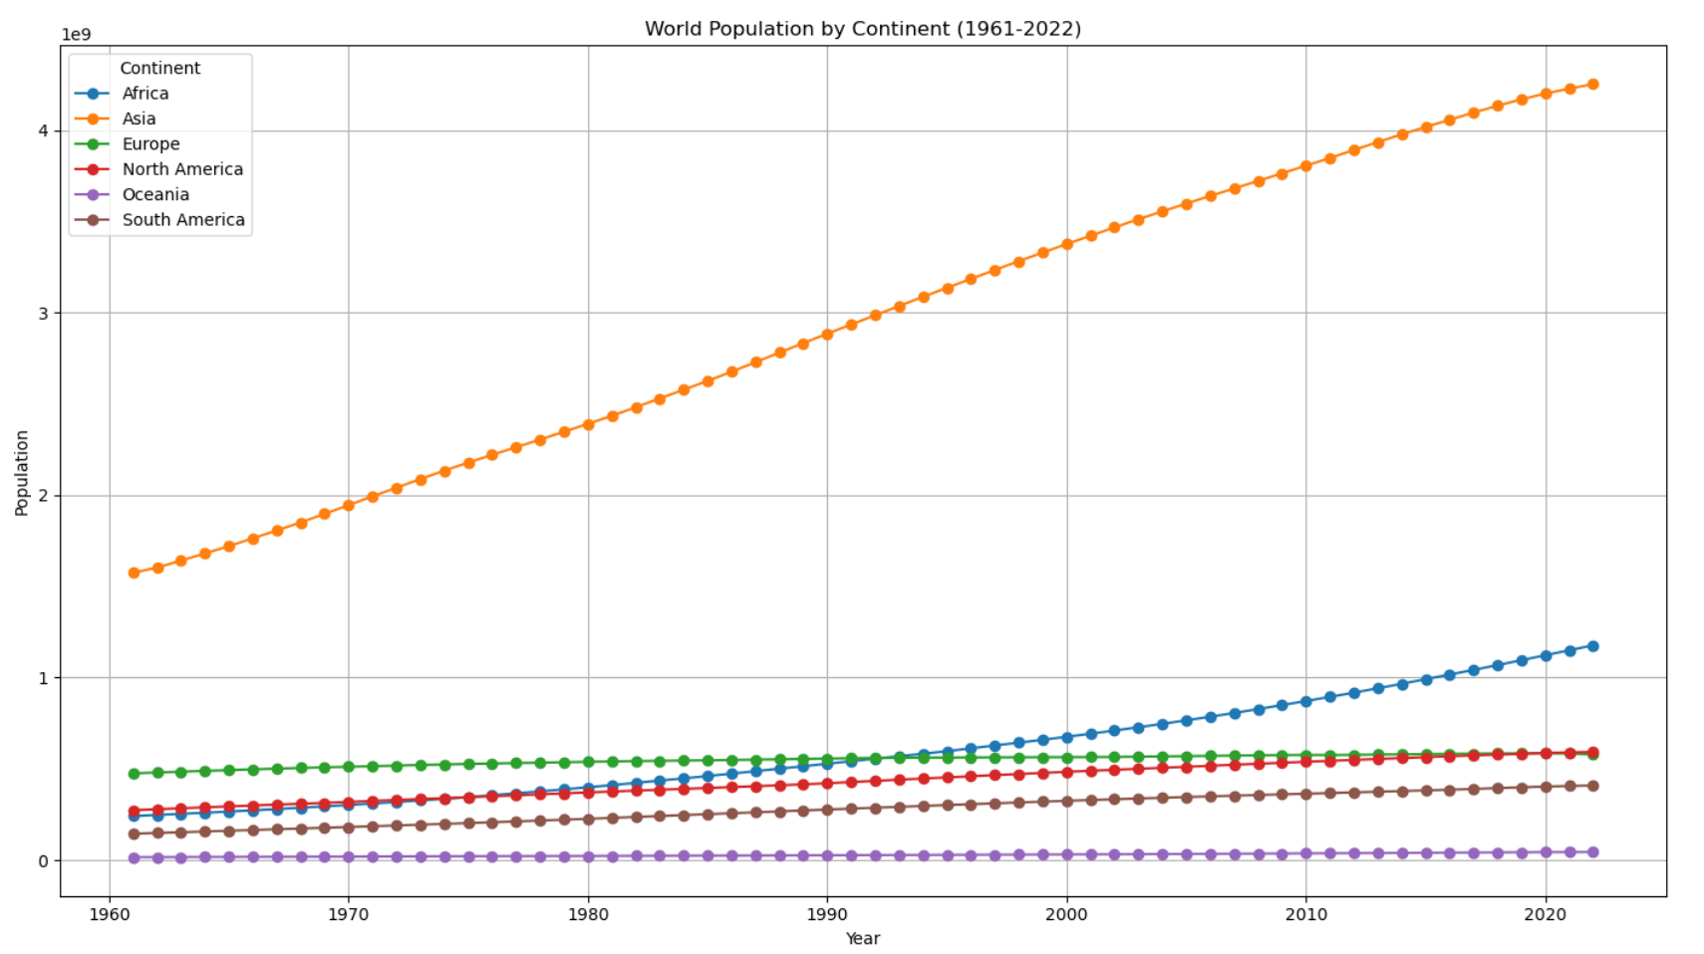

Slide 13
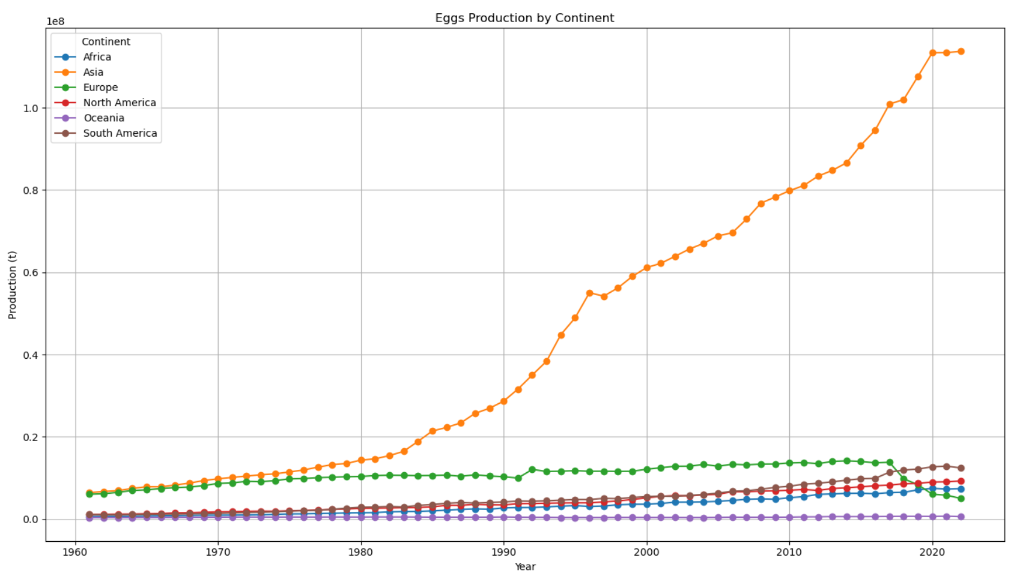

Slide 14
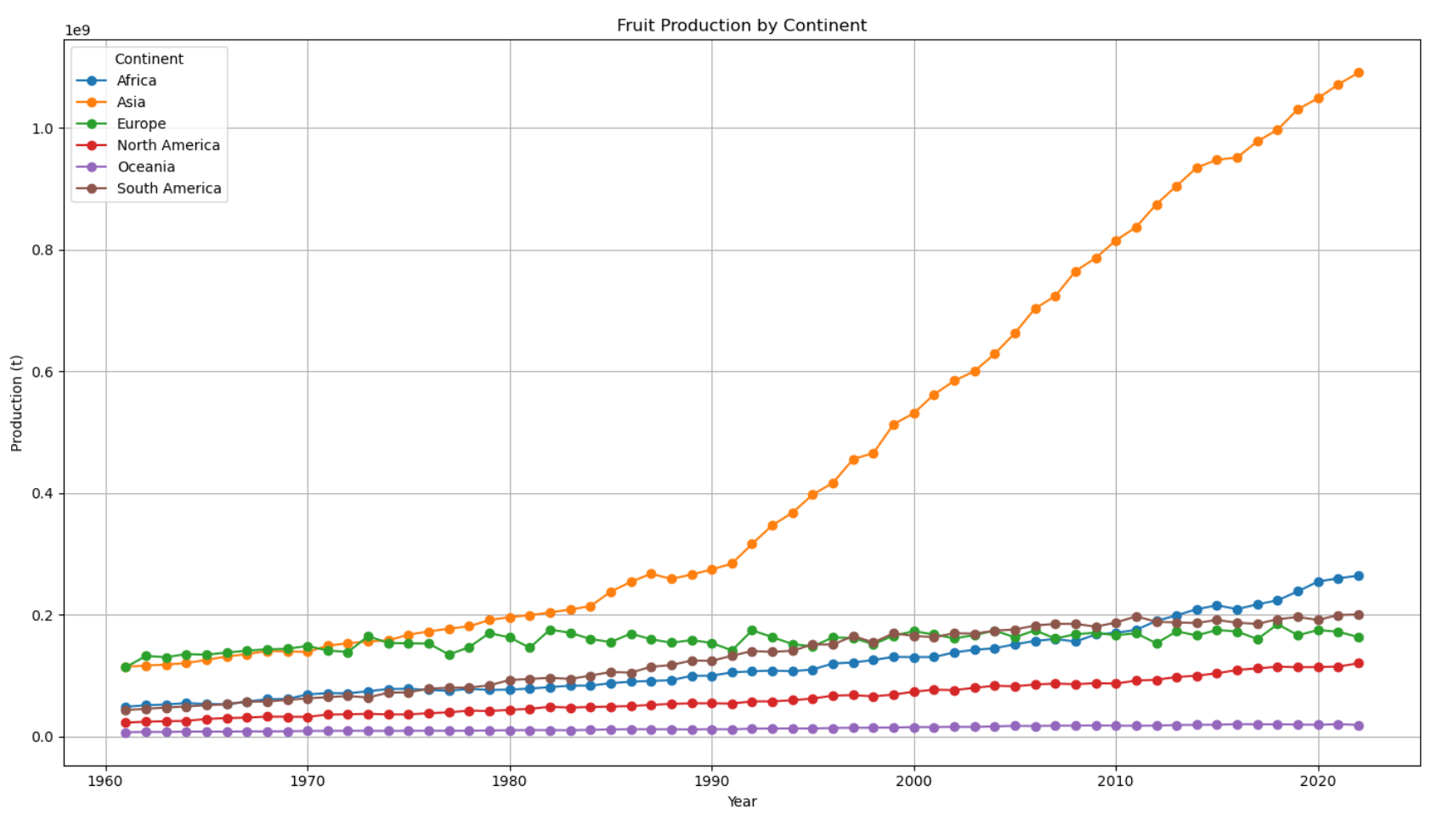

Slide 15
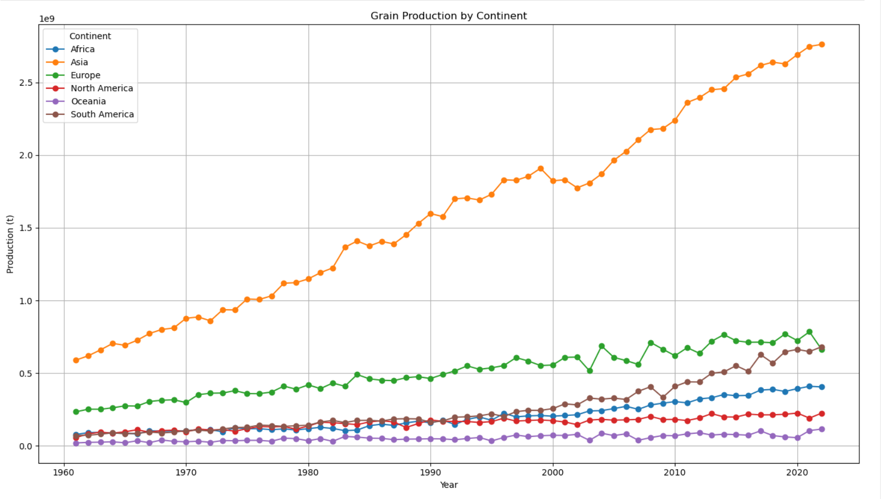

Slide 16
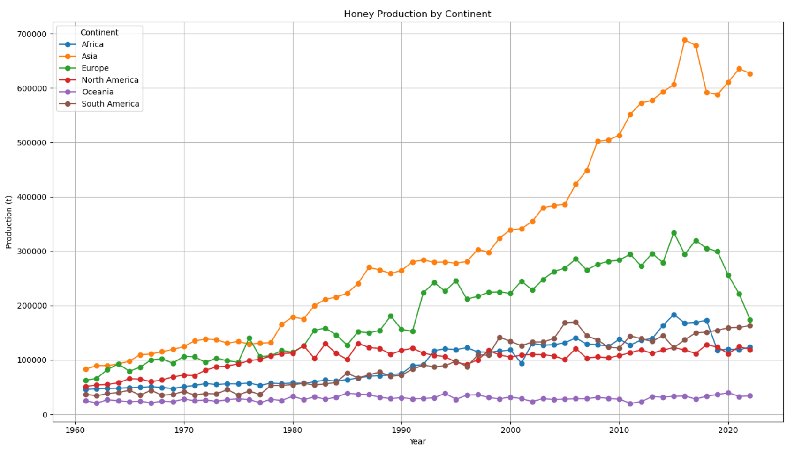

Slide 17
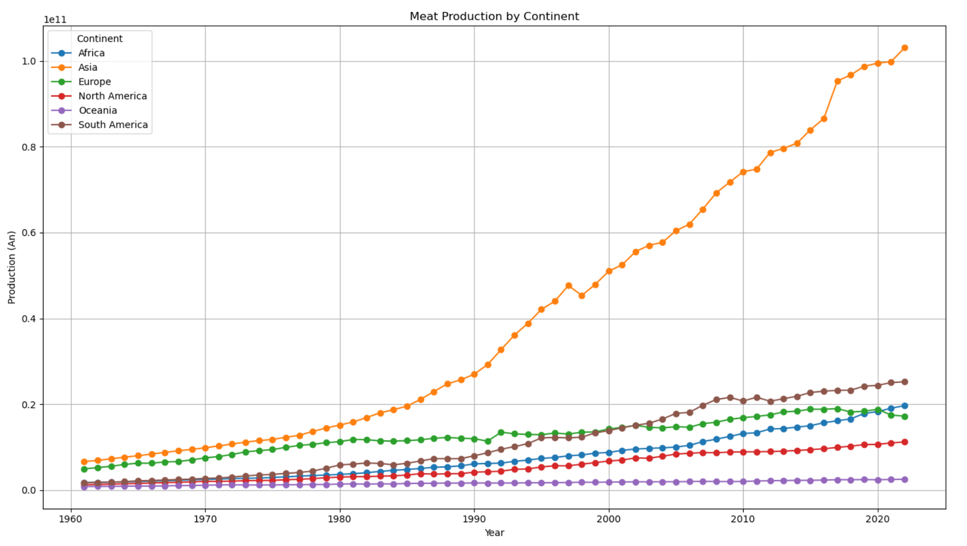

Slide 18
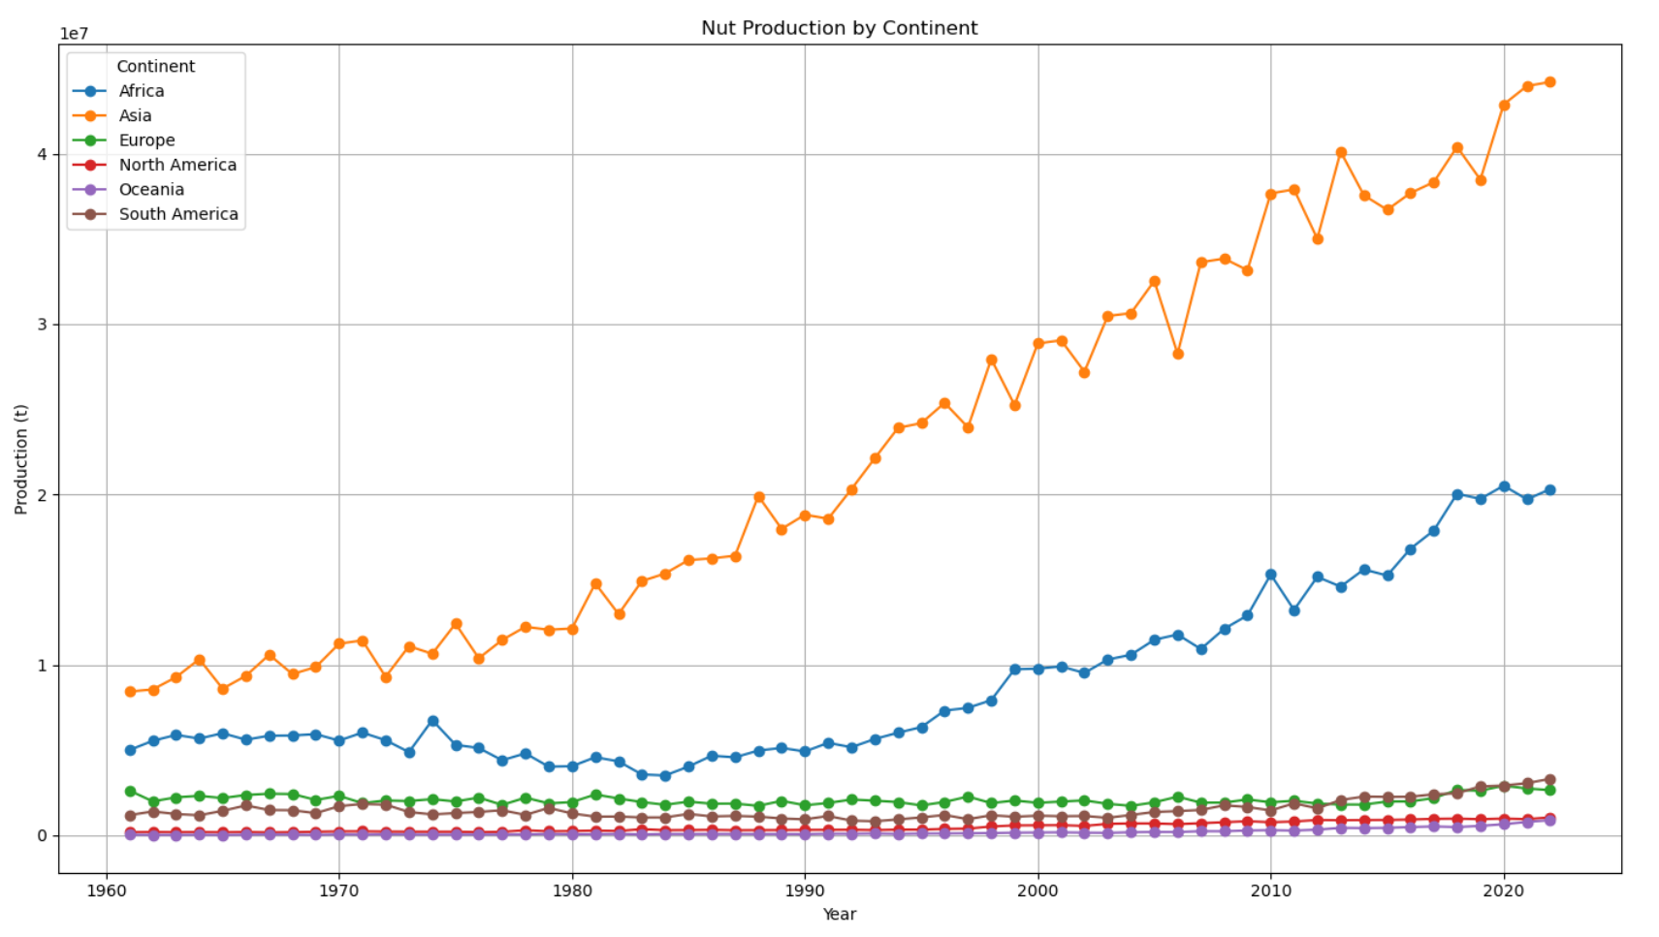

Slide 19
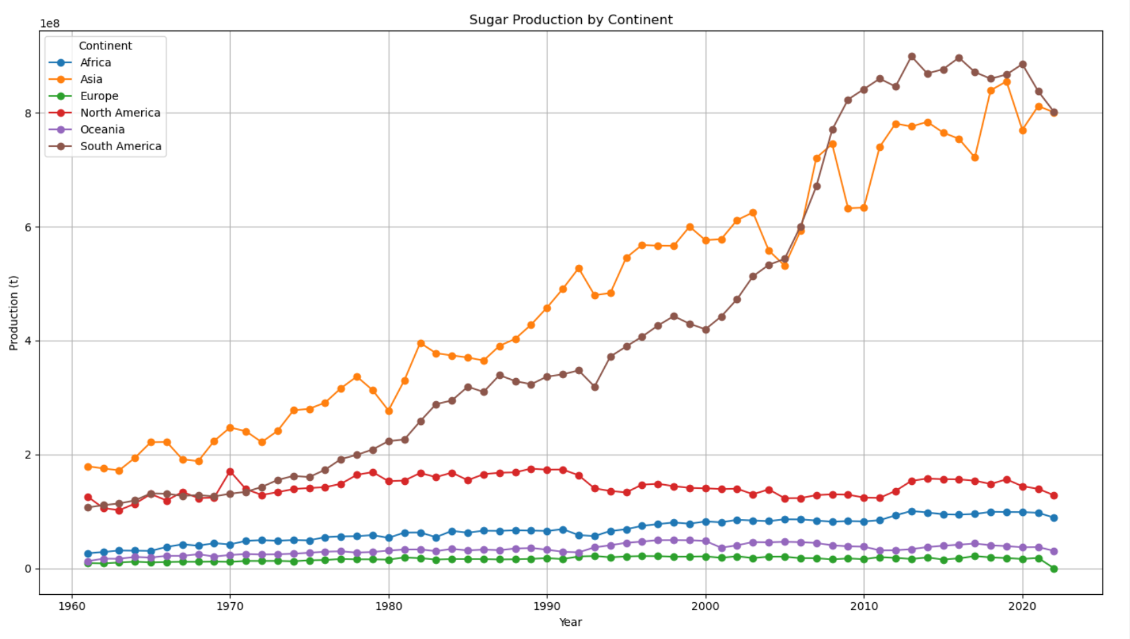

Slide 20
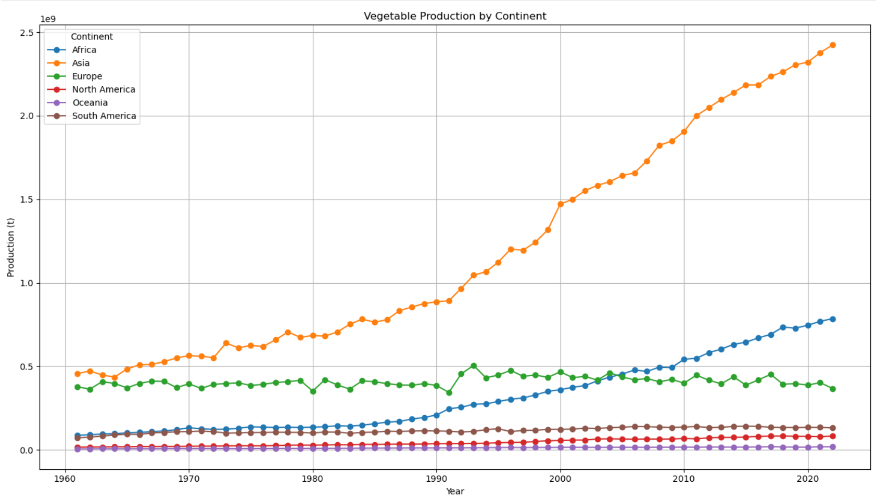

Slide 21
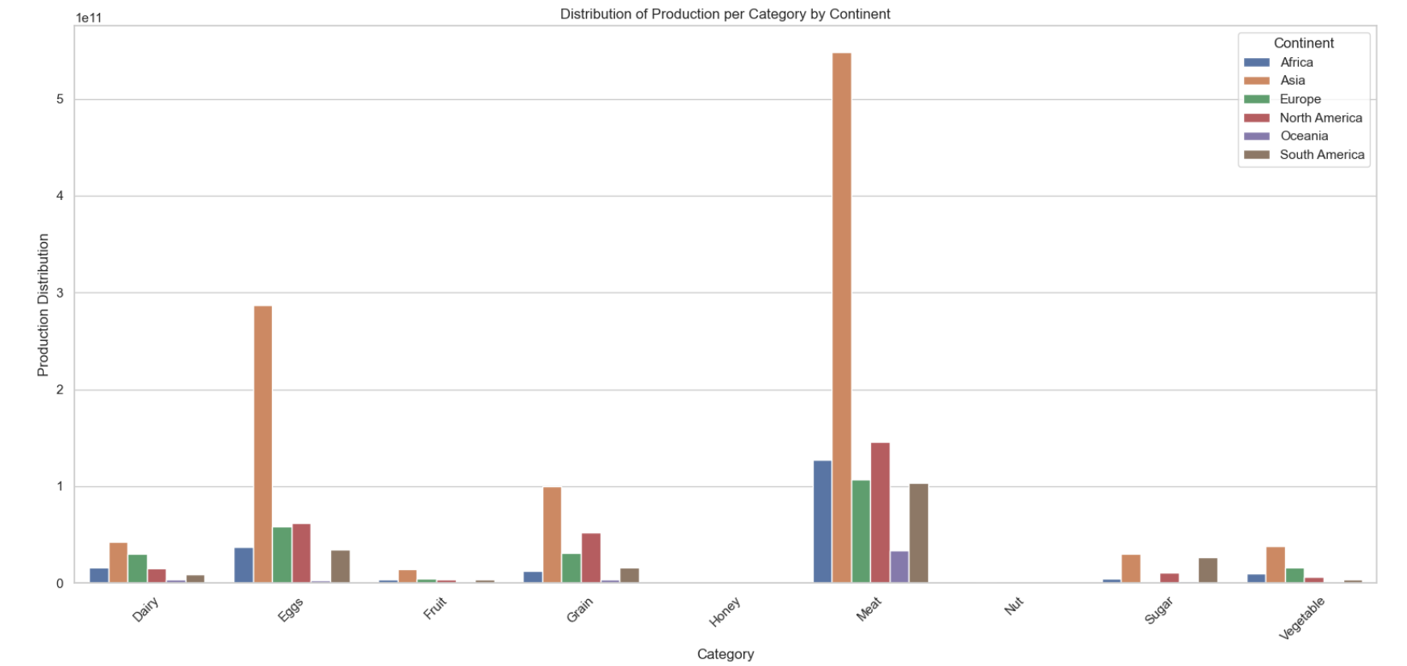
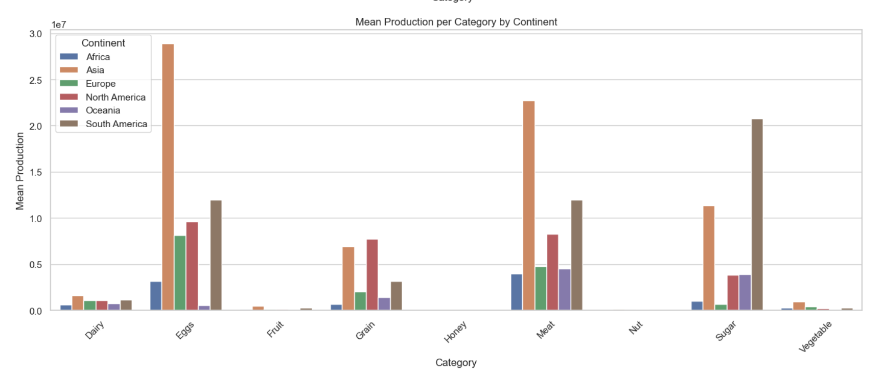
mean
sum

Slide 22
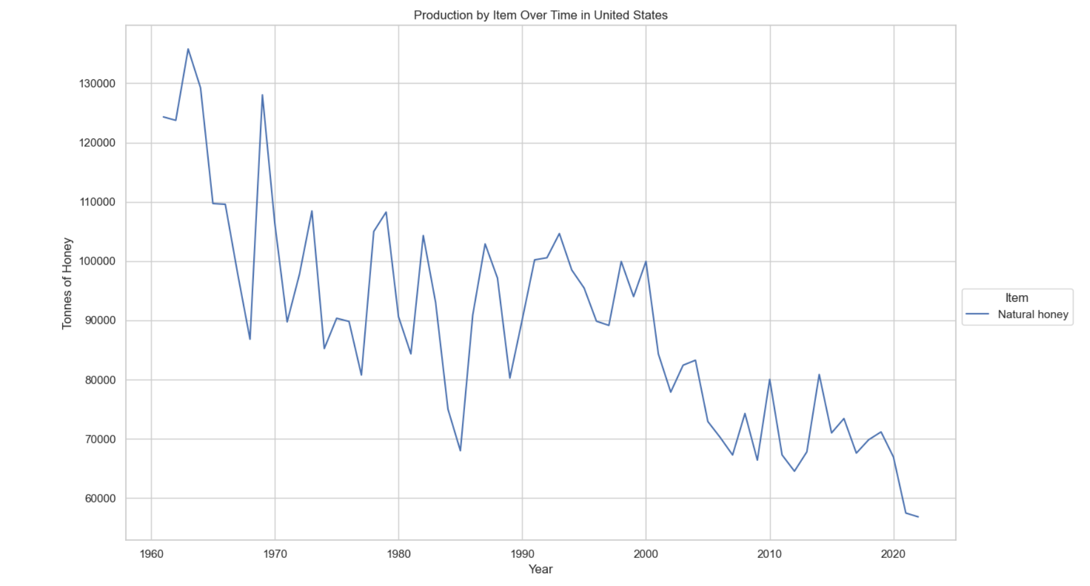
Honey production in the US

Slide 23
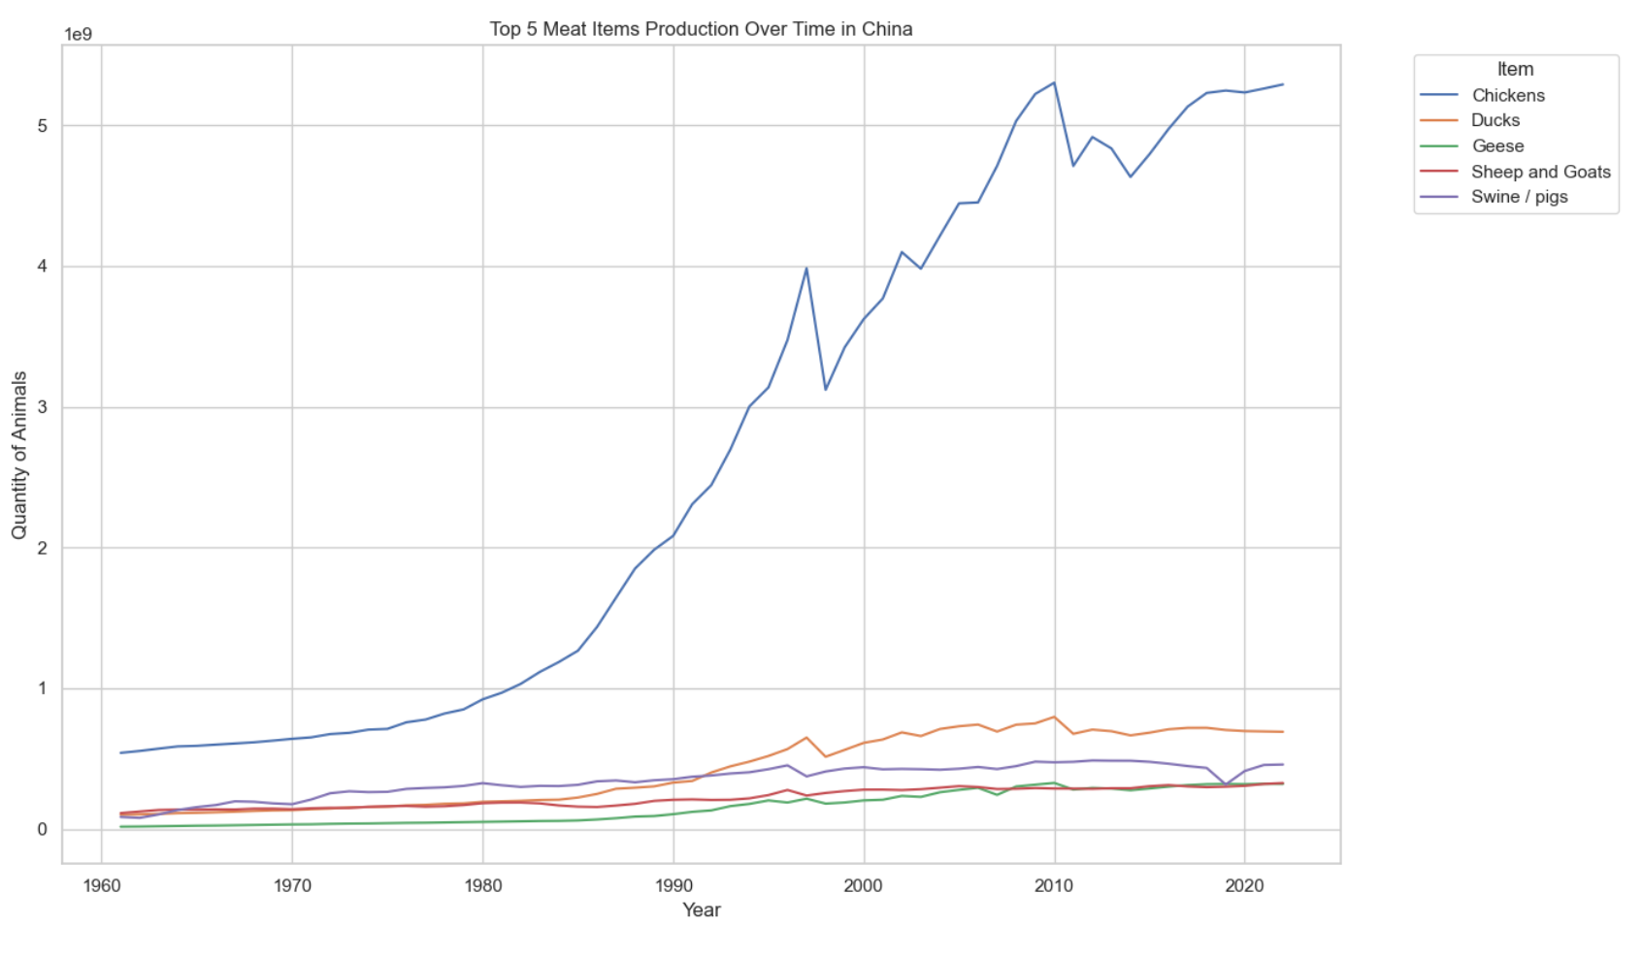
Interesting, chicken is the most produced animal in every continent and almost every country

Slide 24
What trends can be observed in the relationship between agricultural production and population growth?

Slide 25
